Slide 1
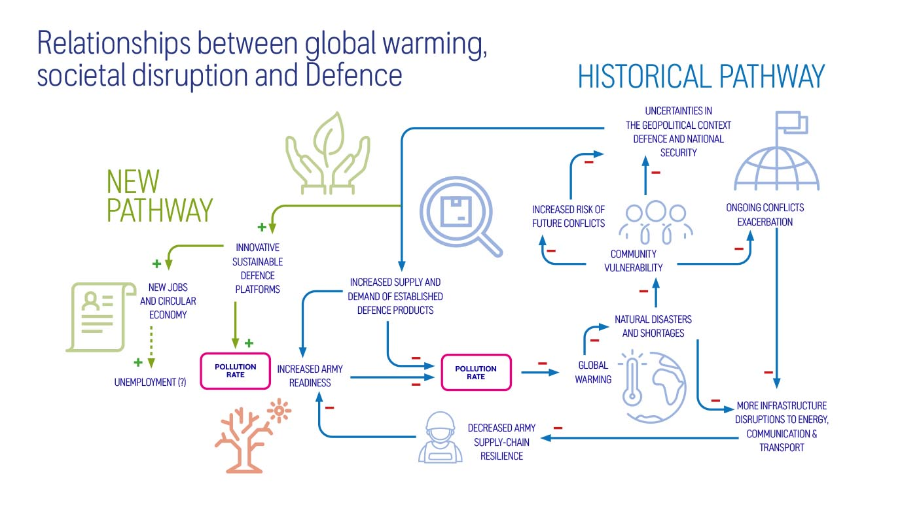
Environmental commitments:
Net-Zero Carbon Emissions
Target: Achieve net-zero operations by 2030 and net-zero products by 2050.
Evidence:
Rolls-Royce reports on its Scope 1, 2, and 3 emissions in its sustainability reports. For example, in its 2022 Sustainability Report, the company disclosed:
Scope 1 = Direct emissions from owned/controlled sources.
Scope 2 = Indirect emissions from purchased energy.
Scope 3 = Other indirect emissions across the value chain.
A 35% reduction in Scope 1 and 2 emissions since 2019.
Progress in reducing emissions from its product portfolio, including testing 100% Sustainable Aviation Fuel (SAF) in its engines.
The company also highlights its collaboration with partners to develop SAF and hybrid-electric propulsion systems, which are critical to achieving its 2050 net-zero goal.

Slide 2
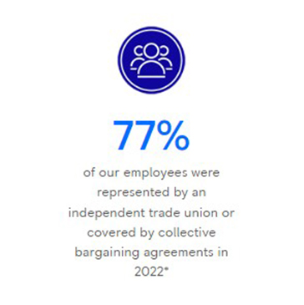
2. Social Commitments and Data
Employee Well-being
Target: Improve employee health, safety, and well-being.
Evidence:
Rolls-Royce reports on its Total Recordable Injury Rate (TRIR), which measures workplace safety. In 2022, the company achieved a TRIR of 0.33, reflecting a strong safety record.
The company also conducts employee surveys to measure engagement and well-being, with results shared in its sustainability reports.

